Slide 1
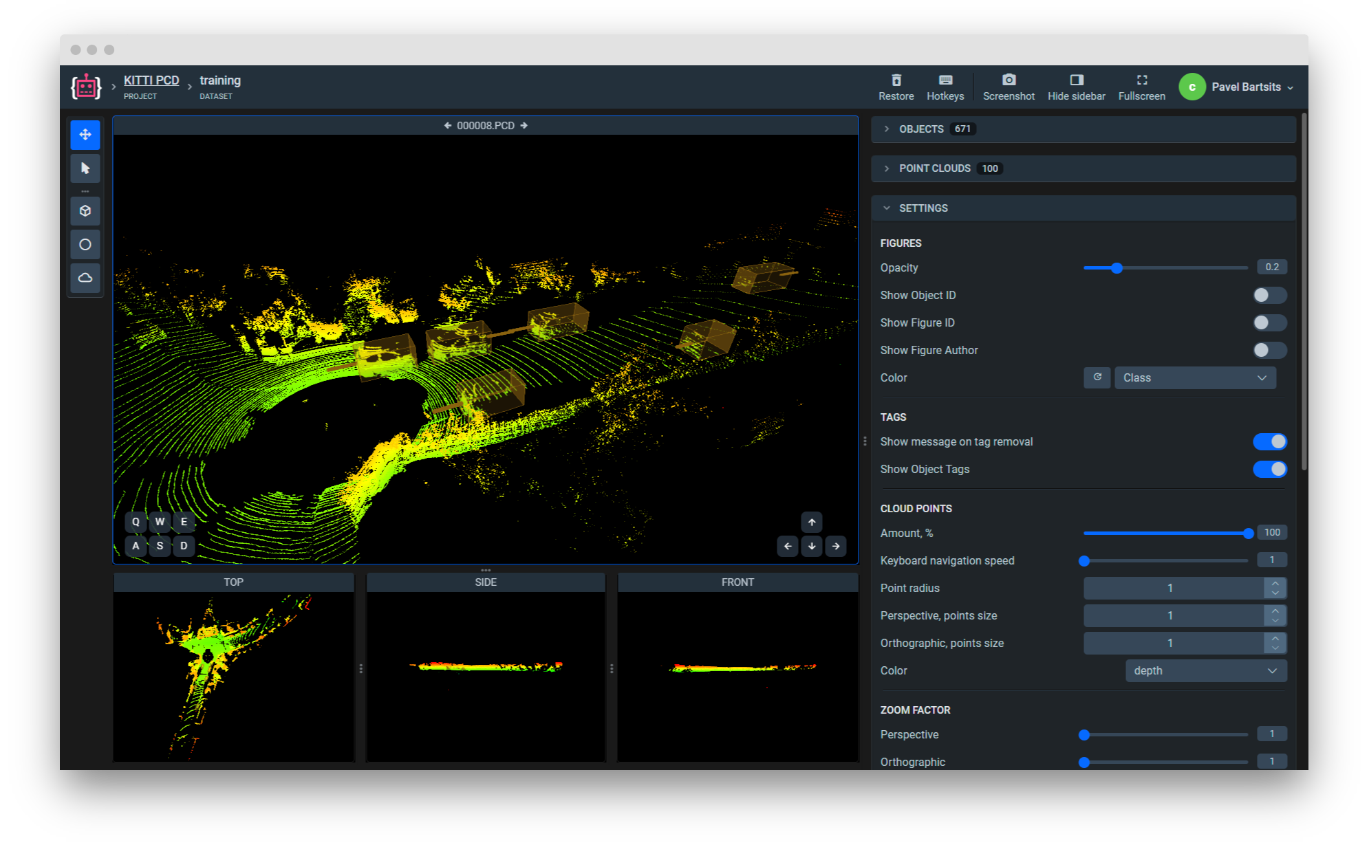
Export Pointclouds Project in Supervisely format
annotations | photocontext | pointclouds

Slide 2
Export Pointclouds Project in Supervisely format
annotations | photocontext | pointclouds

Slide 3
3D Cube Diagrams
Here is where your infographic begins

Slide 4
100%
70%
Mars is actually a cold place. It’s full of iron oxide dust
Venus has a beautiful name and is the second planet from the Sun
50%
20%
Saturn is composed of hydrogen and helium and it’s the ringed one
Mercury is the closest planet to the Sun and the smallest one
A
B
C
D

Slide 5
325
Venus has a beautiful name and is the second planet from the Sun
260
Saturn is composed of hydrogen and helium and it’s the ringed one
215
Mercury is the closest planet to the Sun and the smallest one

Slide 6
MERCURY
MARS
Mercury is the closest planet to the Sun and the smallest one
Mars is actually a cold place. It’s full of iron oxide dust
SATURN
JUPITER
Saturn is composed of hydrogen and helium and is the ringed one
Jupiter is a gas giant and the biggest planet in the Solar System
VENUS
NEPTUNE
Venus has a beautiful name and is the second planet from the Sun
Neptune is the farthest planet from the Sun and the fourth-largest one

Slide 7
A
Venus has a beautiful name and is the second planet from the Sun
B
Saturn is composed of hydrogen and helium and it’s the ringed one
C
Mercury is the closest planet to the Sun and the smallest one

Slide 8
MERCURY
MARS
Mercury is the closest planet to the Sun and the smallest one
Mars is actually a cold place. It’s full of iron oxide dust
SATURN
JUPITER
Saturn is composed of hydrogen and helium and is the ringed one
Jupiter is a gas giant and the biggest planet in the Solar System
VENUS
NEPTUNE
Venus has a beautiful name and is the second planet from the Sun
Neptune is the farthest planet from the Sun and the fourth-largest one

Slide 9
30%
Venus has a beautiful name and is the second planet from the Sun
20%
Saturn is composed of hydrogen and helium and it’s the ringed one
10%
Mercury is the closest planet to the Sun and the smallest one

Slide 10
MERCURY
MARS
Mercury is the closest planet to the Sun and the smallest one
Mars is actually a cold place. It’s full of iron oxide dust
SATURN
JUPITER
Saturn is composed of hydrogen and helium and is the ringed one
Jupiter is a gas giant and the biggest planet in the Solar System
VENUS
NEPTUNE
Venus has a beautiful name and is the second planet from the Sun
Neptune is the farthest planet from the Sun and the fourth-largest one

Slide 11
MERCURY
MARS
Mercury is the closest planet to the Sun and the smallest one
Mars is actually a cold place. It’s full of iron oxide dust
SATURN
JUPITER
Saturn is composed of hydrogen and helium and is the ringed one
Jupiter is a gas giant and the biggest planet in the Solar System

Slide 12
MERCURY
SATURN
JUPITER
MARS
Mercury is the closest planet to the Sun and the smallest one
Saturn is composed of hydrogen and helium and is the ringed one
Jupiter is a gas giant and the biggest planet in the Solar System
Mars is actually a cold place. It’s full of iron oxide dust

Slide 13
MERCURY
JUPITER
Mercury is the closest planet to the Sun and the smallest one
Jupiter is a gas giant and the biggest planet in the Solar System
SATURN
MARS
Saturn is composed of hydrogen and helium and is the ringed one
Mars is actually a cold place. It’s full of iron oxide dust

Slide 14
VENUS
Venus has a beautiful name and is the second planet from the Sun
JUPITER
Jupiter is a gas giant and the biggest planet in the Solar System
SATURN
Saturn is composed of hydrogen and helium and it’s the ringed one
MERCURY
Mercury is the closest planet to the Sun and the smallest one

Slide 15
MERCURY
Mercury is the closest planet to the Sun and the smallest one
JUPITER
Jupiter is a gas giant and the biggest planet in the Solar System
SATURN
Saturn is composed of hydrogen and helium and is the ringed one

Slide 16
1.315.000
1.300.000
1.250.000
MARS
SATURN
JUPITER
Mars is the red planet and is actually a cold place. The surface is full of iron oxide dust
Saturn is a massive ball made mostly of hydrogen and helium. Surrounded by more than 60 moons
Jupiter is the massive planet .It's a stormy mass of raging gas and metallic hydrogen

Slide 17
45%
30%
Mars
Venus
Mars is actually a cold place. It’s full of iron oxide dust
Venus has a beautiful name and is the second planet from the Sun
15%
10%
Saturn
Mercury
Saturn is composed of hydrogen and helium and it’s the ringed one
Mercury is the closest planet to the Sun and the smallest one

Slide 18
01
Mars is the red planet and is actually a cold place. The surface is full of iron
02
Saturn is a massive ball made mostly of hydrogen and helium.
03
Jupiter is the massive planet .It's a stormy mass of raging gas and metallic hydrogen

Slide 19
JUPITER
Jupiter is a gas giant and the biggest planet in the Solar System
MERCURY
Mercury is the closest planet to the Sun and the smallest one
SATURN
Saturn is composed of hydrogen and helium and is the ringed one

Slide 20
VENUS
Venus has a beautiful name and is the second planet from the Sun
JUPITER
Jupiter is a gas giant and the biggest planet in the Solar System
SATURN
Saturn is composed of hydrogen and helium and it’s the ringed one
MERCURY
Mercury is the closest planet to the Sun and the smallest one

Slide 21
10%
30%
NEPTUNE
MARS
Neptune is the farthest planet from the Sun and the fourth-largest one
Mars is the red planet and is actually a cold place
60%
40%
VENUS
JUPITER
Venus has a beautiful name and is the second planet from the Sun
Jupiter is a gas giant and the biggest planet in the Solar System
20%
50%
SATURN
MERCURY
Saturn is composed of hydrogen and helium and it’s the ringed one
Mercury is the closest planet to the Sun and the smallest one

Slide 22
B
D
A
C
SATURN
MERCURY
MARS
JUPITER
Saturn is composed of hydrogen and helium and is the ringed one
Mercury is the closest planet to the Sun and the smallest one
Mars is actually a cold place. It’s full of iron oxide dust
Jupiter is a gas giant and the biggest planet in the Solar System

Slide 23
VENUS
Venus has a beautiful name and is the second planet from the Sun
JUPITER
Jupiter is a gas giant and the biggest planet in the Solar System
MERCURY
Mercury is the closest planet to the Sun and the smallest one
SATURN
Saturn is composed of hydrogen and helium and it’s the ringed one

Slide 24
A
B
C
D
127
Saturn is composed of hydrogen and helium and it’s the ringed one
234
Jupiter is a gas giant and the biggest planet in the Solar System
130
Mercury is the closest planet to the Sun and the smallest one
236
Venus has a beautiful name and is the second planet from the Sun

Slide 25
VENUS
Venus has a beautiful name and is the second planet from the Sun
MERCURY
Mercury is the closest planet to the Sun and the smallest one
SATURN
Saturn is composed of hydrogen and helium and it’s the ringed one

Slide 26
D
MERCURY
JUPITER
C
Mercury is the closest planet to the Sun and the smallest one
Jupiter is a gas giant and the biggest planet in the Solar System
B
A
SATURN
MARS
Saturn is composed of hydrogen and helium and is the ringed one
Mars is actually a cold place. It’s full of iron oxide dust

Slide 27
SATURN
Saturn is composed of hydrogen and helium and it’s the ringed one
JUPITER
Jupiter is a gas giant and the biggest planet in the Solar System
MERCURY
Mercury is the closest planet to the Sun and the smallest one
VENUS
Venus has a beautiful name and is the second planet from the Sun

Slide 28
VENUS
Venus has a beautiful name and is the second planet from the Sun
MERCURY
Mercury is the closest planet to the Sun and the smallest one
SATURN
Saturn is composed of hydrogen and helium and it’s the ringed one

Slide 29
VENUS
MERCURY
Venus has a beautiful name and is the second planet from the Sun
Mercury is the closest planet to the Sun and the smallest one
SATURN
JUPITER
Saturn is composed of hydrogen and helium and it’s the ringed one
Jupiter is a gas giant and the biggest planet in the Solar System

Slide 30
40%
30%
20%
10%
MERCURY
JUPITER
MARS
SATURN
Mercury is the closest planet to the Sun and the smallest one
Jupiter is a gas giant and the biggest planet in the Solar System
Mars is actually a cold place. It’s full of iron oxide dust
Saturn is composed of hydrogen and helium and is the ringed one

Slide 31
SATURN
01
Saturn is composed of hydrogen and helium and it’s the ringed one
JUPITER
02
Jupiter is a gas giant and the biggest planet in the Solar System
MERCURY
03
Mercury is the closest planet to the Sun and the smallest one
VENUS
04
Venus has a beautiful name and is the second planet from the Sun

Slide 32
A
B
C
D
MERCURY
JUPITER
MARS
SATURN
Mercury is the closest planet to the Sun and the smallest one
Jupiter is a gas giant and the biggest planet in the Solar System
Mars is actually a cold place. It’s full of iron oxide dust
Saturn is composed of hydrogen and helium and is the ringed one

Slide 33
Instructions for use
In order to use this template, you must credit Slidesgo and Freepik in your final presentation and include links to both websites.
You are allowed to:
- Modify this template.
- Use it for both personal and commercial projects.
You are not allowed to:
- Sublicense, sell or rent any of Slidesgo Content (or a modified version of Slidesgo Content).
- Distribute Slidesgo Content unless it has been expressly authorized by Slidesgo.
- Include Slidesgo Content in an online or offline database or file.
- Offer Slidesgo templates (or modified versions of Slidesgo templates) for download.
- Acquire the copyright of Slidesgo Content.
For more information about editing slides, please read our FAQs or visit Slidesgo School:
https://slidesgo.com/faqs and https://slidesgo.com/slidesgo-school

Slide 34
Infographics
You can add and edit some infographics to your presentation to present your data in a visual way.
Choose your favourite infographic and insert it in your presentation using Ctrl C + Ctrl V or Cmd C + Cmd V in Mac.
Select one of the parts and ungroup it by right-clicking and choosing “Ungroup”.
Change the color by clicking on the paint bucket.
Then resize the element by clicking and dragging one of the square-shaped points of its bounding box (the cursor should look like a double-headed arrow). Remember to hold Shift while dragging to keep the proportions.
Group the elements again by selecting them, right-clicking and choosing “Group”.
Repeat the steps above with the other parts and when you’re done editing, copy the end result and paste it into your presentation.
Remember to choose the “Keep source formatting” option so that it keeps the design. For more info, please visit Slidesgo School.

